Slide 1
Matrix Profile
Riverside Eamonn Keogh

Slide 2
Matrix Profile I: All Pairs Similarity Joins for Time Series: A Unifying View that Includes Motifs, Discords and Shapelets
A novel scalable algorithm for time series subsequence all-pairs-similarity-search.
For exceptionally large datasets, the algorithm can be trivially cast as an anytime algorithm and produce high-quality approximate solutions in reasonable time.

Slide 3
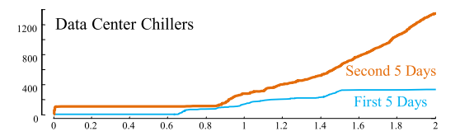
Our algorithm uses an ultra-fast similarity search algorithm under z-normalized Euclidean distance as a subroutine, exploiting the overlap between subsequences using the classic Fast Fourier Transform (FFT) algorithm. Our method has the following advantages/features:
EXACT.
Simple and parameter-free.
Inconsequential space overhead.
Scalable.
Incrementally update it efficiently.
Full joins, without a similarity threshold.
Parallelizable

Slide 4
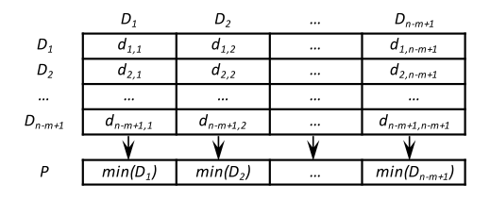
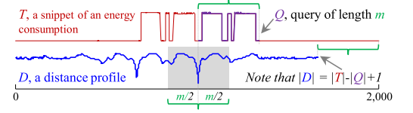
Definitions and Notation
Definition 1: T = t1, t2, ..., tn where n is the length of T.
Definition 2: Ti,m = ti, ti+1,…, ti+m-1, where 1 ≤ i ≤ n-m+1.
Definition 3: A distance profile D is a vector of the Euclidean distances between a given query and each subsequence in an all-subsequences set .
Definition 4: A ={T1,m,, T2,m,…, Tn-m+1,m}, where m is a user-defined subsequence length.

Slide 5
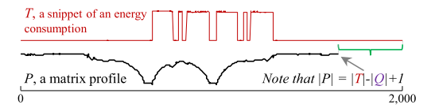
Definitions and Notation
Definition 5: 1NN-join function
Definition 6: Similarity join set: JAB = A⋈r1nnB.
Definition 7: A matrix profile (or just profile) PAB is a vector of the Euclidean distances between each pair in JAB.
Definition 9: A matrix profile index IAB of a similarity join set JAB is a vector of integers where IAB[i] = j if {A[i], B[j]} ∈ JAB.

Slide 6
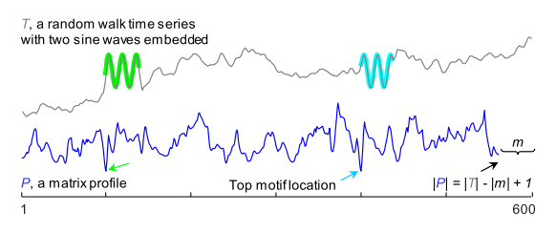
Summary of the Previous Section
We can create two meta time series, the matrix profile and the matrix profile index, to annotate a time series TA with the distance and location of all its subsequences nearest neighbors in itself or another time series TB.
trivial matches
“exclusion-zone”

Slide 7
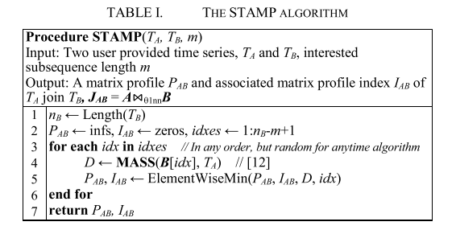
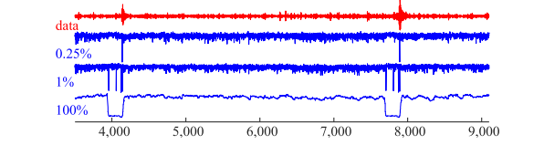

The STAMP Algorithm
An Anytime Algorithm for TSAPSS

Slide 8
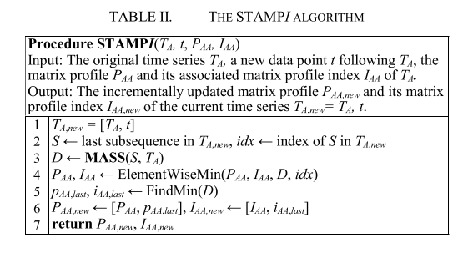
Build the matrix profile incrementally.
Given that we have performed a batch construction of matrix profile, if new data arrives, it would clearly be preferable to incrementally adjust the current profile, rather than start from scratch.

Slide 9
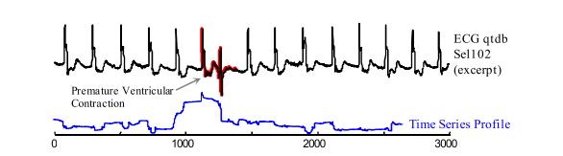
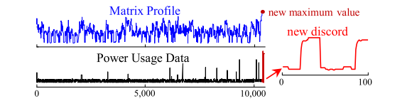

Slide 10
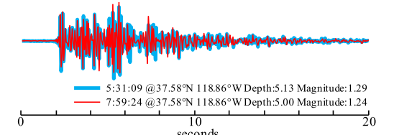
Matrix Profile II: Exploiting a Novel Algorithm and GPUs to Break the One Hundred Million Barrier for Time Series Motifs and Joins
Improve the scalability of exact motif discovery both by leveraging GPU hardware, and by modifying the recently introduced STAMP algorithm.

Slide 11
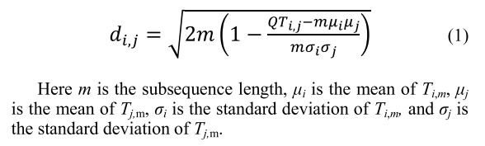
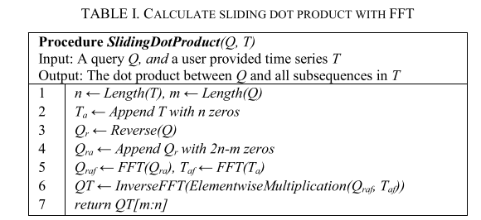
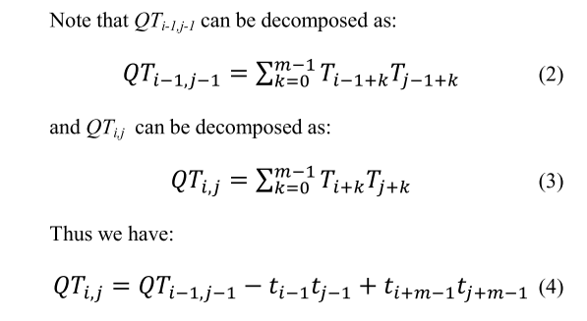
The STOMP Algorithm

Slide 12
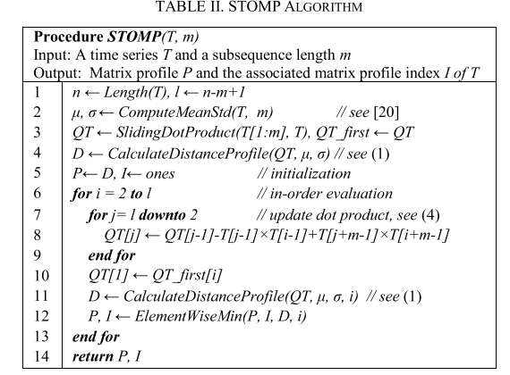
The STOMP Algorithm
The GPU implementation of the STOMP algorithm in TABLE II can be decomposed into four steps:
CPU copies the time series to GPU global memory.
CPU launches GPU kernels to evaluate μ, σ, initial QT, D, P and I.
CPU iteratively launches GPU kernels to update QT, D, P and I.
CPU copies final output (P and I) from GPU.

Slide 13
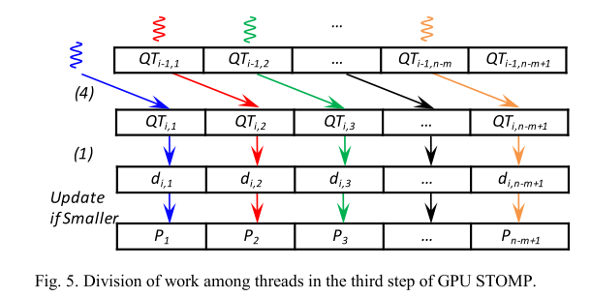
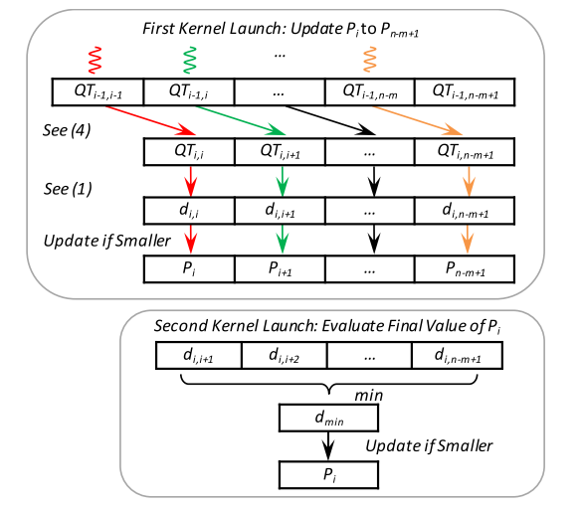
Modifying the third step of GPU-STOMP. top) Launch only n-m-i+2 threads (instead of the n-m+1 threads in Fig. 5) this time at the ith iteration. bottom) Launch another kernel to evaluate the final value of Pi.

Slide 14
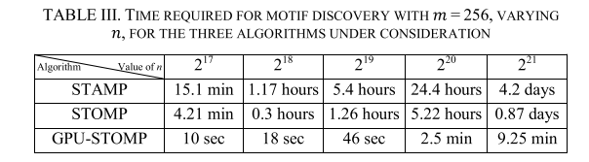
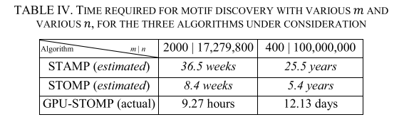
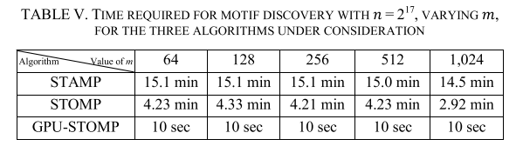
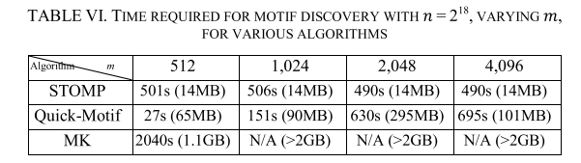
EMPIRICAL EVALUATION

Slide 15
Matrix Profile III: The Matrix Profile Allows Visualization of Salient Subsequences in Massive Time Series
Multidimensional Scaling (MDS)
Minimum Description Length (MDL) subsequence extraction algorithm. Beyond MDS visualization, this subsequence extraction subroutine may be a useful tool in its own right.

Slide 16
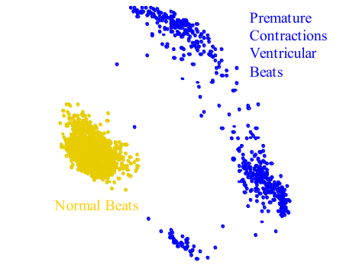
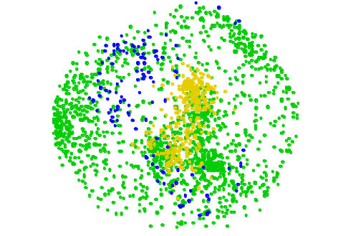
Multidimensional Scaling (MDS) : Given a set of N objects represented by their mutual distances in an N×N distance matrix. The MDS algorithm places each object in K-dimensional space such that the between-object distances are preserved as well as possible. Each object is then assigned coordinates in each of the K dimensions.

Slide 17

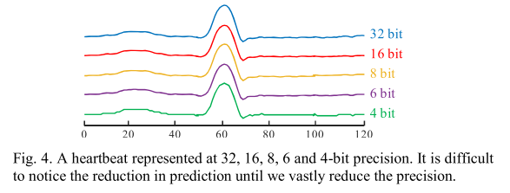

Definitions and Notations
Definition 6: A discrete normalization function DNorm:
Definition 7: The description length DL is a function that calculates the number of bits required for storing a b-bit cardinality, length m time series T.

Slide 18
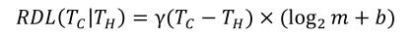
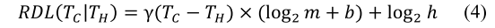

Definitions and Notations
Definition 8: A reduced description length function RDL :
Definition 9: The general formulation for RDL which accounts for the additional information is:
Definition 10: Given the compressible set C, hypothesis set H, and unexplored set U, the total bit cost is computed as:
γ(.) is a function that counts the number of non-zero element in the input vector

Slide 19
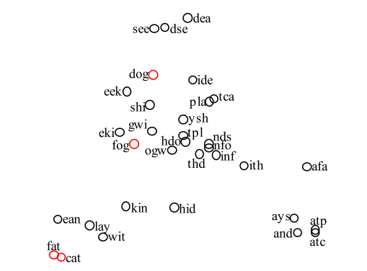
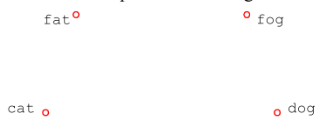
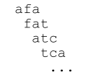
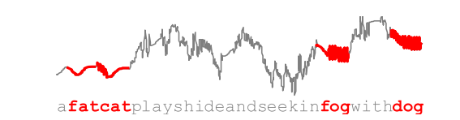


MDS FOR TIME SERIES SUBSEQUENCES

Slide 20
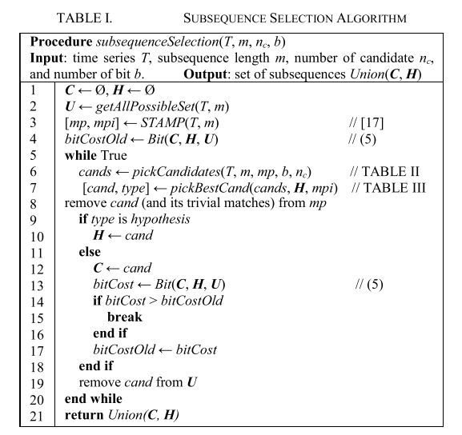
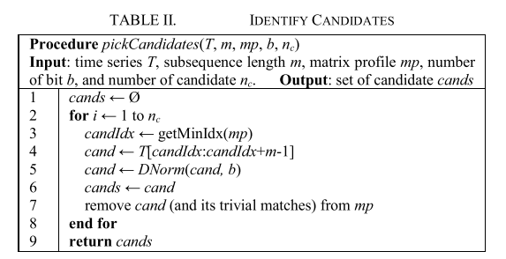

Slide 21
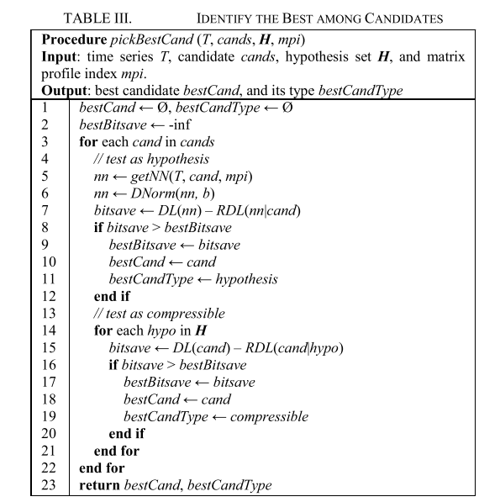
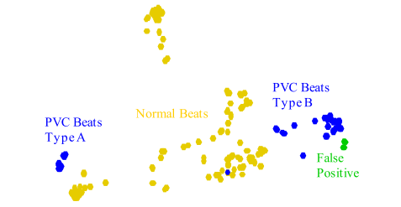

Slide 22
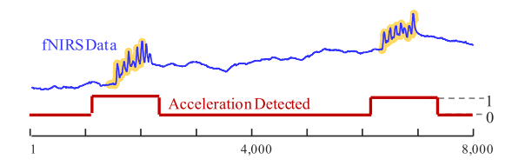
Matrix Profile IV: Using Weakly Labeled Time Series to Predict Outcomes
Weakly labeled data
SDTS, a scalable algorithm that can learn in such challenging settings.
The weakly labeled time series learning task-at-hand reduces to the following:
Suppose that we are given such training data ahead of time, but in the future, the Boolean time series will become unavailable (perhaps for some technical or privacy issue).
Can we reconstruct the Boolean time series given just the real-valued signal?

Slide 23
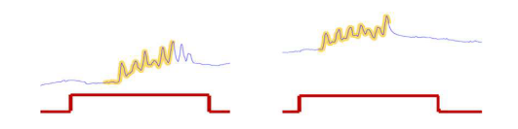
INTRODUCTION
Threshold-based rule:
But if the height of the real-valued time series is unrelated to the Boolean value ?
If PT > 100.4° F then HF ←TRUE
Shape features

Slide 24
The real-valued/Boolean task-at-hand here is significantly more difficult for the following reasons :
INTRODUCTION
Noisy Labels
Label Slop
Class Skew
Scale
Multi-Scale Polymorphic Patterns

Slide 25
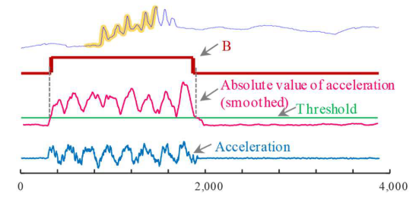
DEFINITIONS AND NOTATION
Definition 4: A Boolean time series B ∈ {0,1} which annotated T is a sequence of binary values bi ∈ {0,1} ∶ B = [b1, b2, . . . , bn] where n is the length of B and the length of T.
Definition 5: The weakly labeled time series problem is the task of generating the binary time series B′ of a given real-valued time series T′ using knowledge (e.g., rules) acquired from the previously seen binary time series B and real-valued time series T.
Definition 6: A dictionary is a set of shapes S (possibly of different lengths), each with an associated threshold H.

Slide 26
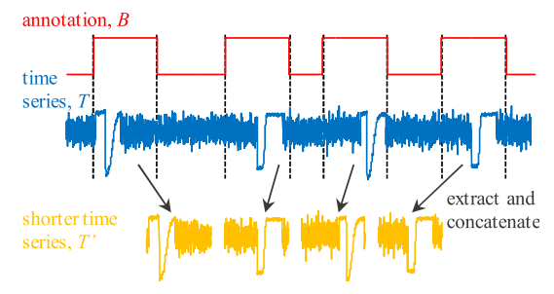
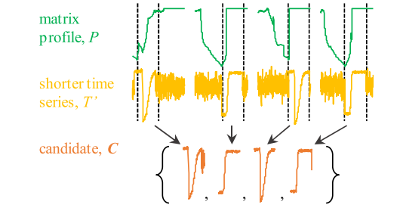
Learning the Dictionary

Slide 27
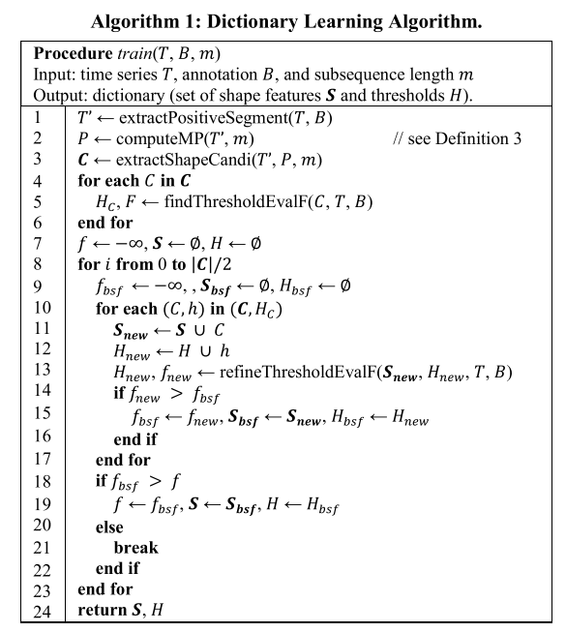
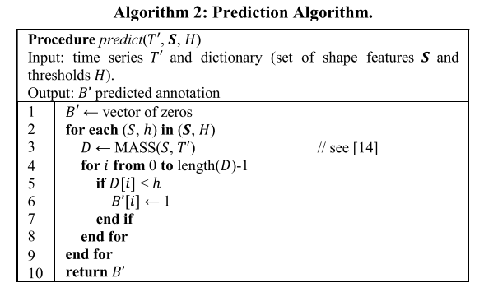

Slide 28
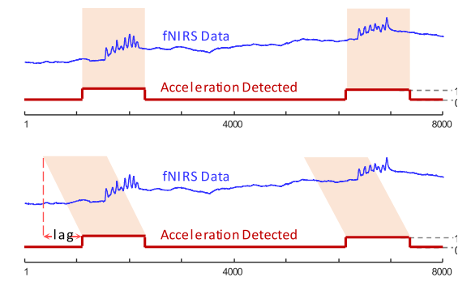
CONCLUSION
In conclusion, we have introduced SDTS, a parameter-free domain agnostic algorithm for learning from weakly supervised datasets.

Slide 29
Matrix Profile V: A Generic Technique to Incorporate Domain Knowledge into Motif Discovery
The user’s intent/expectations
The motif discovery search outcomes.
The most interesting patterns
The more frequent patterns

Slide 30
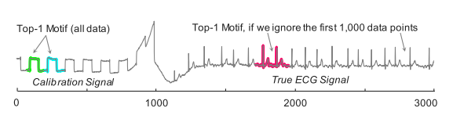
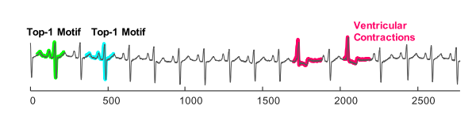
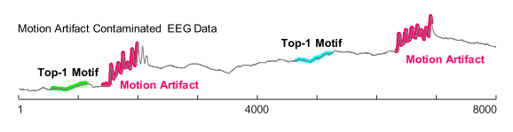
A snippet of ECG data from BIDMC Congestive Heart Failure Database
These known/uninteresting patterns may obscure a much rarer and unexpected repeated pattern

Slide 31
The basic idea is to produce a vector that is “parallel” to the original time series and annotates it with the user’s constraint(s). As the motif discovery algorithm finds candidate motifs, this annotation vector (AV) is used to re-rank them, allowing the motifs that best balance the fidelity of conservation with the user’s constraints to rise to the top.
The annotation vector AV is a time series consisting of real-valued numbers between [0 - 1].
A low value
A meaningless motif
A high value
A desirable motif

Slide 32
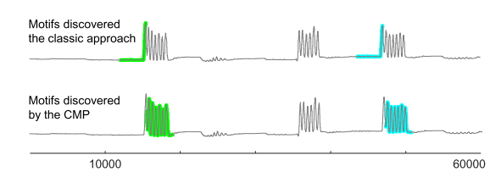
A Corrected Matrix Profile (CMP) by combining the annotation vector AV and the original matrix profile MP:
The resulting corrected MP can be interpreted as follow: if a region of the time series potentially contains the meaningful motifs, its MP values are left untouched. Otherwise, its MP values are “pushed” higher (increased) to reduce the possibility of any motif in that region appears in the top-K motif list.

Slide 33
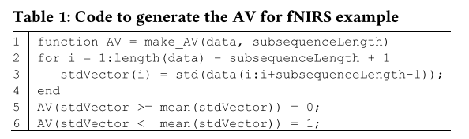
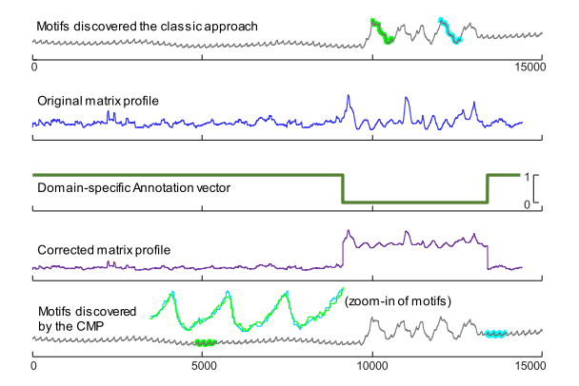
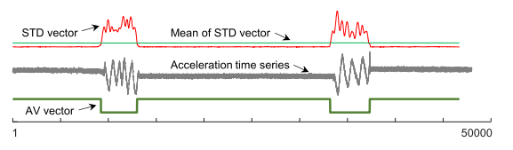
3.1 Case Study: Suppressing Motion Artifact.

Slide 34
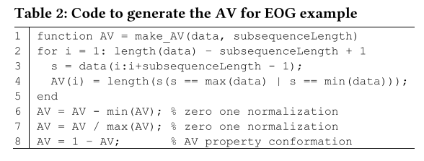



3.2 Case Study: Suppressing Hard-Limited Artifacts.

Slide 35


3.3 Case Study: Stop-Word Motif Bias

Slide 36


We test the performance of three alternatives:
Classic motif search, to reflect what is currently done in the literature (Classic).
Guided Motif Search: In which the AV is created using complexity bias (AVcomplexity).
Guided Motif Search: In which the AV is created using the number of zeros-crossings (AVZeroCrossings) in the subsequences.

